Slide 1
Chapter 5 Induction and Recursion
Section 3
Recursive Definitions and Structural Induction

Slide 2
Outline
Introduction
Recursively Defined Functions
Recursively Defined Sets and Structures
Structural Induction

Slide 3
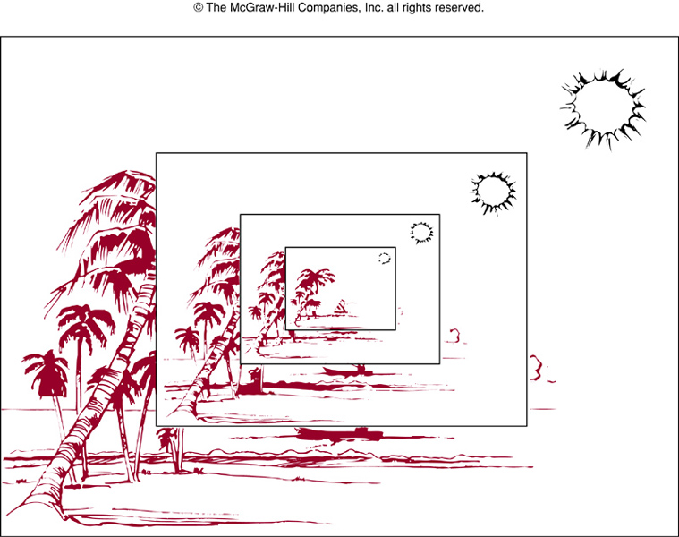
Introduction
A recursively defined picture

Slide 4
Introduction
Remark.
  The sequence of powers of 2 is given by a_{n}=2^{n} for n=0, 1, 2, …
  It can also be defined by a₀=1, and a rule for finding a term of the sequence from the previous one, i.e., a_{n+1}=2a_{n}
  We can use induction to prove results about the sequence
Structural induction
  We define a set recursively by specifying some initial elements in a basis step and provide a rule for constructing new elements from those already in the recursive step

Slide 5
Recursively Defined Functions
Recursive or inductive definition.
  Two steps are used to define a function with the set of non-negative integers as its domain
    Basis step: specify the value for the function at zero
    Recursive step: give a rule for finding its value at an integer from its values at smaller integers
  Such a definition is called a recursive or inductive definition

Slide 6
Recursively Defined Functions
Example.
  Suppose f is defined recursively by
    f(0)=3
    f(n+1)=2f(n)+3
  Find f(1), f(2), f(3), and f(4)
  Solution.
    f(1)=2f(0)+3=2*3+3=9
    f(2)=2f(1)+3=2*9+3=21
    f(3)=2f(2)+3=2*21+3=45
    f(4)=2f(3)+3=2*45+3=93

Slide 7
Recursively Defined Functions
Example.
  Give an inductive definition of the factorial function f(n)=n!
  Solution.
  Note that (n+1)!=(n+1)∙n!
  We can define f(0)=1 and f(n+1)=(n+1)f(n)
  To determine a value, e.g., f(5)=5!, we can use the recursive function
  f(5)=5f(4)=5∙4f(3)=5∙4∙3f(2)=5∙4∙3∙2f(1)
  =5∙4∙3∙2∙1f(0)=5∙4∙3∙2∙1∙1=120

Slide 8
Recursively Defined Functions
Remark.
  Recursively defined functions are well defined
    For every positive integer, the value of the function is determined in an unambiguous way
    Given any positive integer, we can use the two parts of the definition to find the value of the function at that integer
    And that we obtain the same value no matter how we apply two parts of the definition

Slide 9
Recursively Defined Functions
Example.
  Given a recursive definition of a^{n}, where a is a non-zero real number and n is a non-negative integer
  Solution.
  Note that a^{n+1}=a∙a^{n} and a⁰=1
  These two equations uniquely define a^{n} for all non-negative integer n

Slide 10
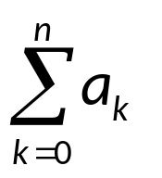
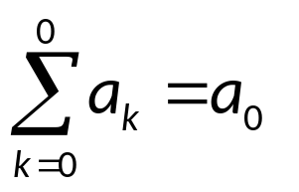
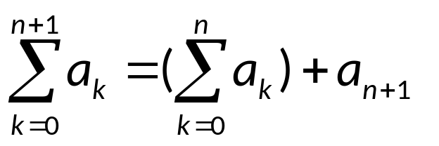
Recursively Defined Functions
Example.
  Given a recursive definition of
  The first part of the recursive definition is
  The second part is

Slide 11
Recursively Defined Functions
Example. (Fibonacci numbers)
  f₀, f₁, f₂, are defined by the equations, f₀=0, f₁=1, and f_{n}=f_{n-1} +f_{n-2} for n=2, 3, 4, …
  By definition
  f₂=f₁+f₀=1+0=1
  f₃=f₂+f₁=1+1=2
  f₄=f₃+f₂=2+1=3
  f₅=f₄+f₃=3+2=5
  f₆=f₅+f₄=5+3=8
Example. (Fibonacci numbers)
  Use strong induction to show when n≥3, f_{n}>α^{n-2} where f_{n} is a Fibonacci number and α = (1+√5)/2.

Slide 12
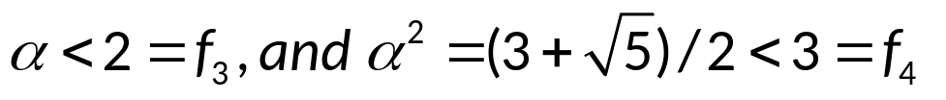
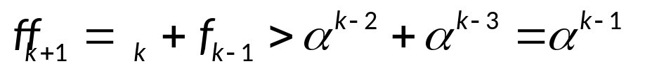
Recursively Defined Functions
  Proof.
  Let p(n) be the proposition that f_{n}>α^{n-2}
  Basis step: note that
  so that p(3) and p(4) are true
  Inductive step: assume p(j) is true, i.e., f_{j}>α^{j-2} with 3≤j≤k where k≥4. We need to show that p(k+1) is true, i.e., f_{k+1}>α^{k-1}
  First note that α is a solution to x²-x-1=0, so α²= α+1, thus
  By inductive hypothesis, if k≥4, it follows f_{k-1}>α^{k-3} , f_{k}>α ^{k-2}
  So,
  It follows that p(k+1) is true. This completes the proof.

Slide 13
Recursively Defined Sets and Structures
Example.
  Consider the subset S of the set of integers defined by
    Basis step: 3∈S
    Recursive step: if x∈S and y∈S, then x+y∈S
  The new elements formed by this are 3+3=6, 3+6=9, 6+6=12, …
  We will show that S is the set of all positive multiples of 3 (P.26)

Slide 14
Recursively Defined Sets and Structures
Definition. (String)
  The set Σ* of strings over the alphabet Σ can be defined recursively by
    Basis step: λ∈Σ * (where λ is the empty string containing no symbols)
    Recursive step: if w∈Σ* and x∈Σ then wx∈Σ*
  The basis step defines that the empty string belongs to string
  The recursive step states new strings are produced by adding a symbol from Σ to the end of stings in Σ*
  At each application of the recursive step, strings containing one additional symbol are generated

Slide 15
Recursively Defined Sets and Structures
Example.
  If Σ={0, 1}, the strings found to be in Σ*, the set of all bit strings, are
    λ, specified to be in Σ* in the basis step
    0 and 1, formed in the 1st recursive step
    00, 01, 10, and 11, formed in the 2nd recursive step
    and so on …

Slide 16
Recursively Defined Sets and Structures
Concatenation of Strings.
  Two strings can be combined via the operation of concatenation (串联)
  Let Σ be a set of symbols, Σ* be the set of strings formed from symbols in Σ. We can define the concatenation for two strings by recursive steps
    Basis step: if w∈Σ*, then w∙λ=w, where λ is the empty string
    Recursive step: If w₁∈Σ* and w₂∈Σ*, then w₁∙(w₂ x)=(w₁∙w₂)x
  Oftentimes w₁∙w₂ is rewritten as w₁w₂
  e.g., w₁=abra, and w₂=cadabra, w₁w₂=abracadabra

Slide 17
Recursively Defined Sets and Structures
Length of a String.
  Give a recursive definition of l(w), the length of a string w
  The length of a string is defined by
    Basis step: l(λ)=0
    Recursive step: l(wx)=l(w)+1 if w∈Σ* and x∈Σ

Slide 18
Recursively Defined Sets and Structures
Well-formed formulae.
  We can define the set of well-formed formulae for compound statement forms involving T, F, proposition variables and operators from the set {¬, ∧, ∨, →, ↔}
    Basis step: T, F, and s, where s is a propositional variable are well-formed formulae
    Recursive step: If A and B are well-formed formulae, then (¬A), (A∧B), (A∨B), (A→B), (A↔B) are well-formed formulae
  Example.
  From an initial application of the recursive step, we know that (p∨q), (p→F), (F→q) and (q∧F) are well-formed formulae, where p, q are propositional variables
  A second application of the recursive step shows that ((p∨q)→(q∧F)), (q∨(p∨q)), and ((p→F)→T) are well-formed formulae

Slide 19
Recursively Defined Sets and Structures
Rooted Trees. (根树)
  The set of rooted trees, where a rooted tree consists of a set of vertices containing a distinguished vertex called the root, and edges connecting these vertices, can be defined recursively by
    Basis step: a single vertex r is a rooted tree
    Recursive step: suppose that T₁,T₂, …,T_{n} are disjoint rooted trees with roots r₁, r₂, …, r_{n}, respectively. Then the graph formed by starting with a root r, which is not in any of the rooted trees T₁, T₂, …, T_{n}, and adding an edge from r to each of the vertices r₁, r₂, …, r_{n}, is also a rooted tree

Slide 20
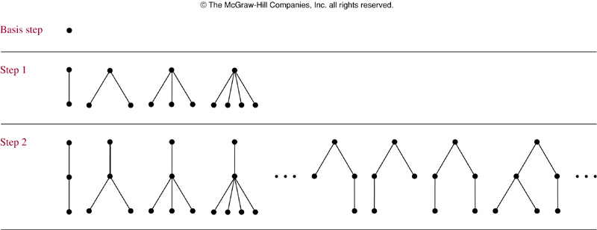
Recursively Defined Sets and Structures
Rooted Trees.

Slide 21
Recursively Defined Sets and Structures
Binary Trees.
  At each vertex, there are at most two branches (one Left Subtree and one Right Subtree)
  Extended binary trees:
    the left subtree or the right subtree can be empty
  Full binary trees:
    must have left and right subtrees

Slide 22
Recursively Defined Sets and Structures
Extended Binary Trees.
  The set of extended binary trees can be defined by
    Basis step: the empty set is an extended binary tree
    Recursive step: If T₁ and T₂ are disjoint extended binary trees, there is an extended binary tree, denoted by T₁ ∙ T₂, consisting of a root r together with edges connecting the root to each of the roots of the left subtree T₁ and right subtree T₂, when these trees are non-empty

Slide 23
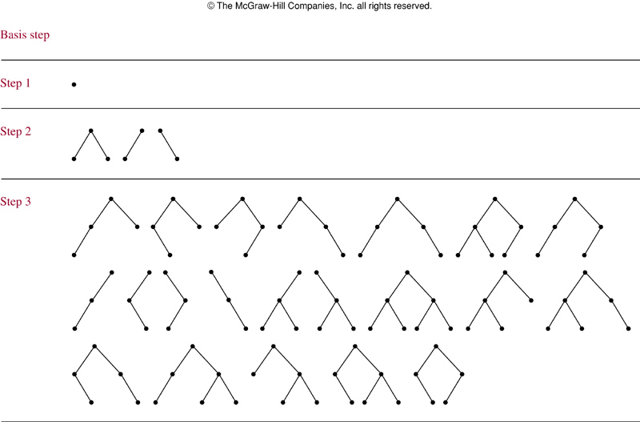
Recursively Defined Sets and Structures
Extended Binary Trees.

Slide 24
Recursively Defined Sets and Structures
Full Binary Trees.
  The set of full binary trees can be defined recursively
    Basis step: There is a full binary tree consisting only of a single vertex r
    Recursive step: If T₁ and T₂ are disjoint full binary trees, there is a full binary tree, denoted by T₁ ∙ T₂, consisting of a root r together with edges connecting the root to each of the roots of the left subtree T₁ and right subtree T₂

Slide 25
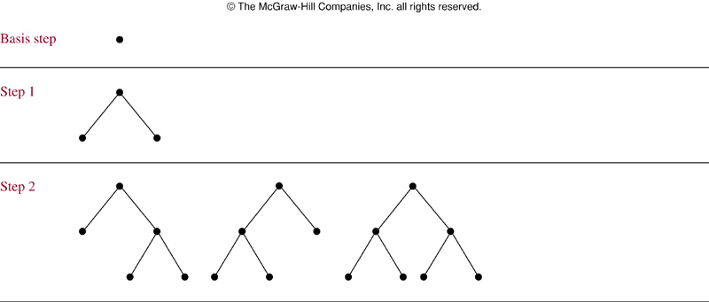
Recursively Defined Sets and Structures
Full Binary Trees.

Slide 26
Structural Induction
Remark.
  To prove results about recursively defined sets we generally use some form of mathematical induction
Example.
  Show that the set S defined by
    Basis step: 3∈S and
    Recursive step: if x∈S and y∈S, then x+y∈S,
    is the set of multiples of 3
  Proof.
  Let A be the set of all positive integers divisible by 3
  To prove A=S, we must show that A⊆S, and S⊆A
  (1) To show A⊆S, we must show that every positive integer divisible by 3 is in S
  Use mathematical induction to prove it

Slide 27
Structural Induction
  Proof. (continued)
  Let p(n) be the statement that 3n belongs to S
    Basis step: it holds as the first part of recursive definition of S, 3⋅1=3∈S
    Inductive step: assume that p(k) is true, i.e., 3k is in S. As 3k∈S and 3∈S, it follows from the 2nd part of the recursive definition of S that
  3k+3=3(k+1)∈S.
  So p(k+1) is true

Slide 28
Structural Induction
  Proof. (continued)
  (2) To show that S⊆A, we use recursive definition of S
  By the basis step of the definition, 3 is in S
  As 3=3⋅1, all elements specified to be in S in this step are divisible by 3, and therefore in A
  To finish the proof, we need to show that all integers in S generated using the recursive step of the definition are in A
  This consists of showing that x+y is in A whenever x and y are elements of S, also assumed to be in A
  If x and y are both in A, it follows that 3|x, 3|y, and thus 3|x+y

Slide 29
Structural Induction
Structural Induction. (结构归纳法)
  A more convenient form of induction, structural induction, can be used to prove a result about a recursively defined set
    Basis step: show that the result holds for all elements specified in the basis step of the recursive definition to be in the set
    Recursive step: show that if the statement is true for each of the elements used to construct new elements in the recursive step of the definition, the result holds for these new elements.

Slide 30
Structural Induction
Trees and structural induction.
  To prove properties of trees with structural induction
    Basis step: show that the result is true for the tree consisting of a single vertex
    Recursive step: show that if the result is true for the trees T₁ and T₂, then it is true for T₁⋅T₂, consisting of a root r, which has T₁ as its left subtree and T₂ as its right subtree

Slide 31
Structural Induction
Height of Binary Tree
  We define the height h(T) of a full binary tree T recursively
    Basis step: the height of the full binary tree T consisting of only a root r is h(T)=0
    Recursive step: If T₁ and T₂ are full binary trees, then the full binary tree T= T₁⋅ T₂ has height h(T)=1+max(h(T₁), h(T₂))

Slide 32
Structural Induction
Number of Vertices in a Binary Tree
  If we let n(T) denote the number of vertices in a full binary tree, we observe that n(T) satisfies the following recursive formula:
    Basis step: the number of vertices n(T) of the full binary tree consisting of only a root r is n(T)=1
    Recursive step: If T₁ and T₂ are full binary trees, then the number of vertices of the full binary tree T= T₁⋅ T₂ is n(T)=1+n(T₁)+n(T₂)

Slide 33
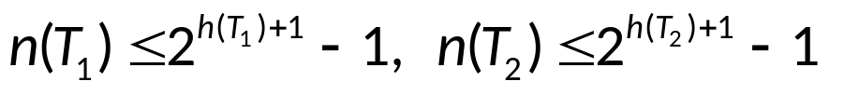
Structural Induction
Theorem.
  If T is a full binary tree T, then n(T)≤2^{h(T)+1}-1
  Proof.
  Use structural induction to prove the theorem
  Basis step: for the full binary tree consisting of just the root r, the result is true as n(T)=1 and h(T)=0, so n(T)=1≤2⁰⁺¹-1=1
  Inductive step: For the inductive hypothesis we assume that
  where T₁ and T₂ are full binary trees
  By the recursive formulae for n(T) and h(T), we have n(T)=1+n(T₁)+n(T₂) and h(T)=1+max(h(T₁), h(T₂))

Slide 34
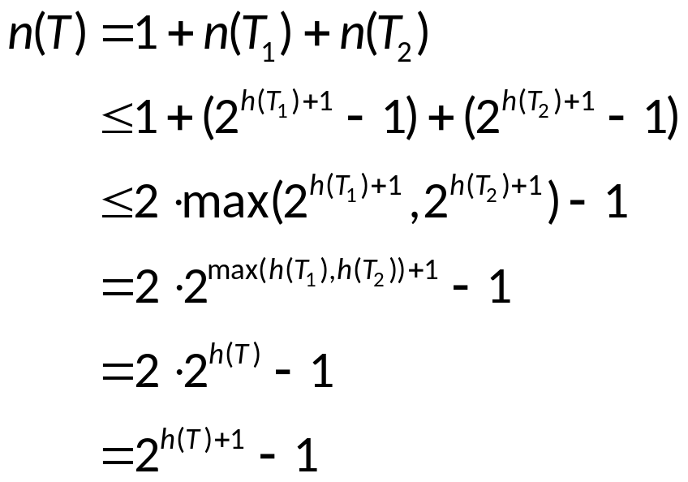
Structural Induction
  Proof. (continued)
  Thus,
  This completes the inductive step.

Slide 35
Assignment
Exercises after 4.3: No.22, 43 (Ver.6)
Exercises after 5.3: No.(Ver.7)

